Slide 1

Arab Uprisings: Econometric Analysis of Saudi Arabia
By
Ravichandra
Batch 23
Class 2016-17

Slide 2
Aim: To find out the factors which attracting and each factor will be taking how many years to boost the FDI inflows into Saudi Arabia

Slide 3
What is 'Econometrics‘ Econometrics is the application of statistical and mathematical theories in economics for the purpose of testing hypotheses and forecasting future trends. It takes economic models, tests them through statistical trials and then compare and contrast the results against real-life examples.

Slide 4
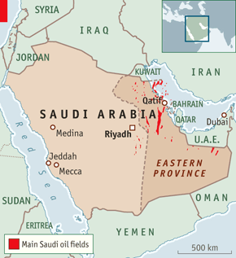
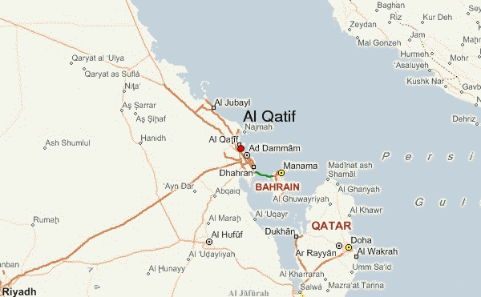

Slide 5
Saudi Arabia
Population: 27,345,986
note: immigrants make up more than 30% of the total population, according to UN data (2013) (July 2014 est.)
Urbanization: 82.3% of total population (2011)
Rate of urbanization: 2.38% annual rate of change (2010-15 est.)
Capital: Riyadh
Ethnic groups: Arab 90%, Afro-Asian 10%
Religion: Muslim (official; citizens are 85-90% Sunni and 10-15% Shia), other (includes Eastern Orthodox, Protestant, Roman Catholic, Jewish, Hindu, Buddhist, and Sikh) (2012 est.)

Slide 6
Economy
0il-based economy with strong government controls
Possesses about 16% of the world's proven petroleum reserves, ranks as the largest exporter of petroleum, and plays a leading role in OPEC.
Petroleum sector accounts for roughly 80% of budget revenues, 45% of GDP, and 90% of export earnings.
Encourages the growth of the private sector in order to diversify its economy and to employ more Saudi nationals: focus on power generation, telecommunications, natural gas exploration, and petrochemical sectors.
Over 6 million foreign workers play an important role in the Saudi economy, particularly in the oil and service sectors,

Slide 7
Economy
High unemployment:10.5% (2013 est.), data are for Saudi males only (local bank estimates; other estimates are as high as 25%)
Struggling to reduce unemployment among its own nationals: focus on large youth population which lacks education and technical skills
Has substantially boosted spending on job training and education, most recently with the opening of the King Abdallah University of Science and Technology - Saudi Arabia's first co-educational university.
As part of its effort to attract foreign investment, Saudi Arabia acceded to the WTO in 2005.
The government has begun establishing six "economic cities" in different regions of the country to promote foreign investment and plans to spend $373 billion between 2010 and 2014 on social development and infrastructure projects to advance Saudi Arabia's economic development.

Slide 8
Government
Conventional long form: Kingdom of Saudi Arabia
Government Type: Monarchy
Constitution: governed according to Shari'a law; the Basic Law that articulates the government's rights and responsibilities was introduced in 1993
Administrative Divisions: 13 provinces - Al Bahah, Al Hudud ash Shamaliyah, Al Jawf, Al Madinah, Al Qasim, Ar Riyad, Ash Sharqiyah, 'Asir, Ha'il, Jizan, Makkah, Najran, Tabuk

Slide 9
Data and Assumptions:
Data taken from “World Bank” database
The Variable values collected are based on the surveys and the expert systems
Independence of observations from each other
Foreign direct investment is a response variable and the remaining variables as predictors
Same variables have mentioned in different units in the data, so considered all variables in a single unit by assuming that the values are interdependent

Slide 10
Data Resources
http://data.worldbank.org/
http://unctadstat.unctad.org
http://www.imf.org/external/index.htm

Slide 11
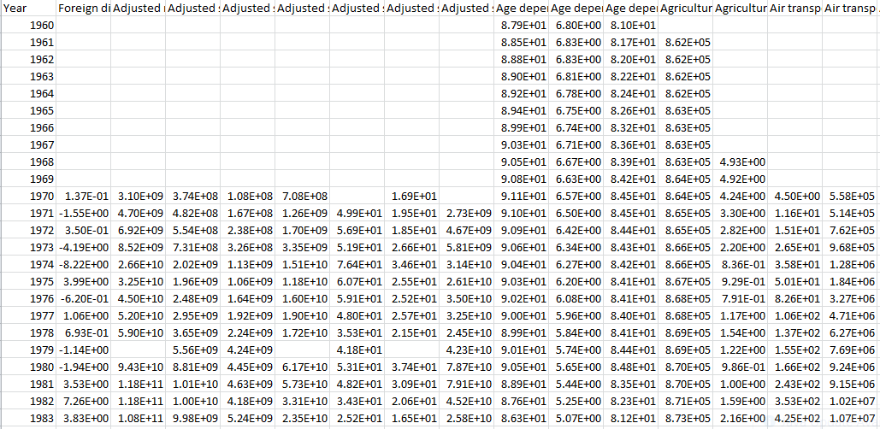
Data At Glance

Slide 12
Preprocessing Steps:
Data contains 1532 NA values
Imputed NAs using Time series(imputeTS) imputation method
Deleted those columns which have <50% of the values out of total data
Nullified the Year column when Regression model applied on the data
Loaded the required Libraries

Slide 13
Algorithms Used:
Random Forest used for extracting top features from the Imputed data
Mulitple Linear Regression model applied on the top features
stepAIC applied on the top features which extracted from Random Forest
Time series by Lags on the top features

Slide 14
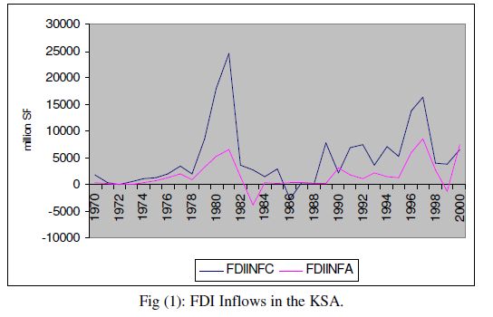
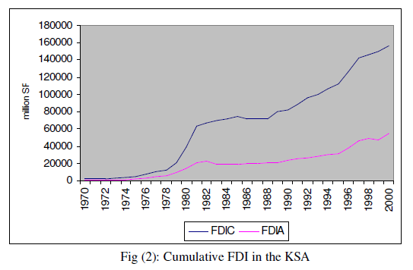
FDI inflow trend in KSA from 1970 to 2000

Slide 15
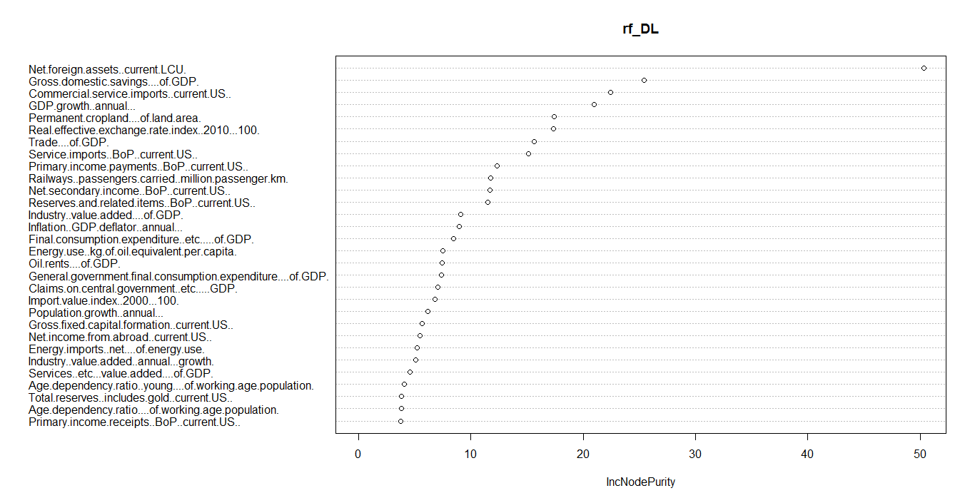
Results:
Top 30 Features from Random Forest

Slide 16
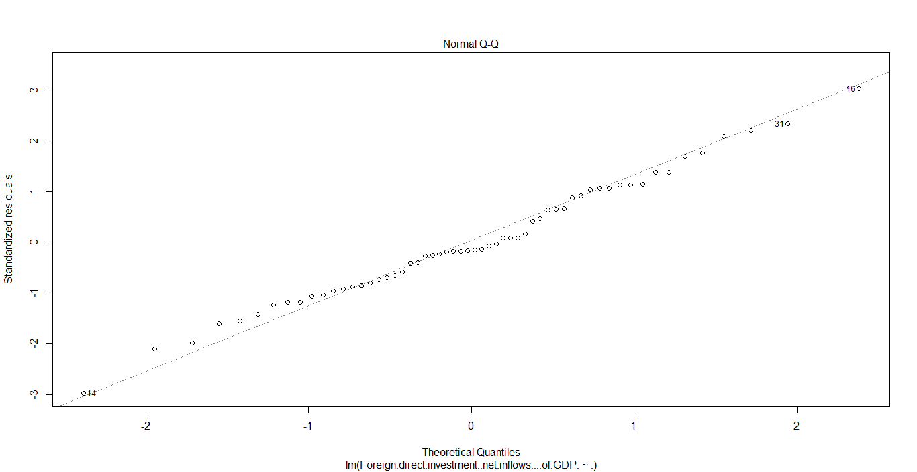
Results: Assumptions observed for MLR
Assumption 1:Errors are normally distributed

Slide 17
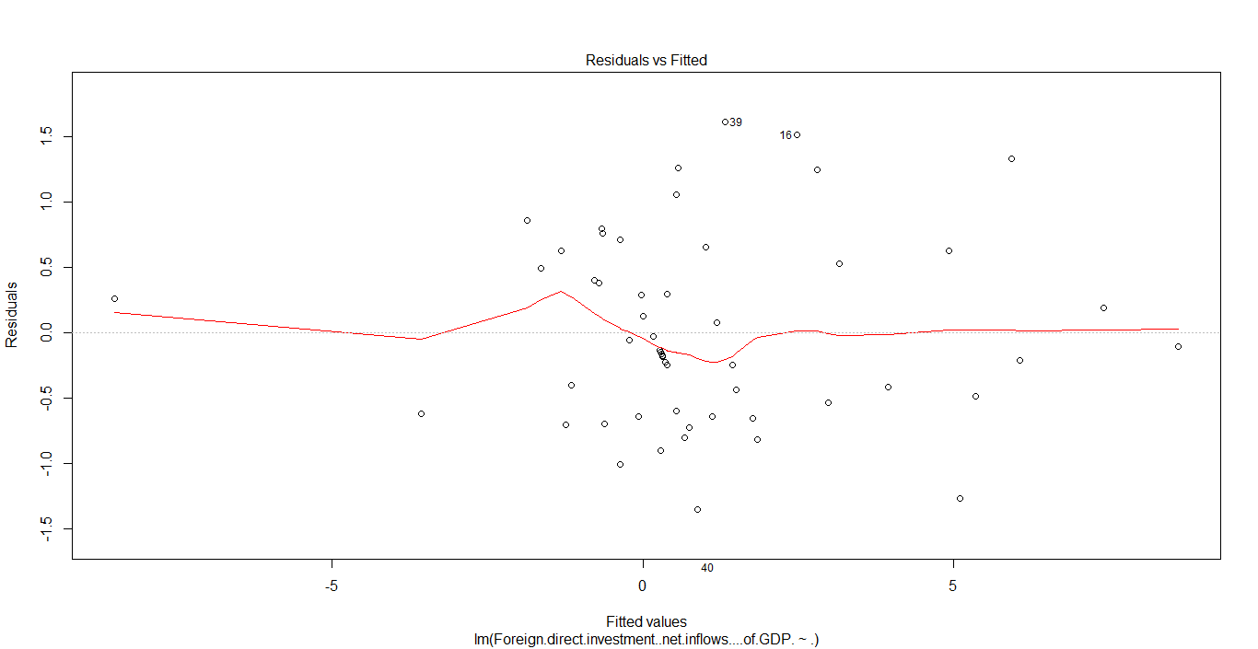
Results: Assumptions observed for MLR
Assumption 2: Linear

Slide 18
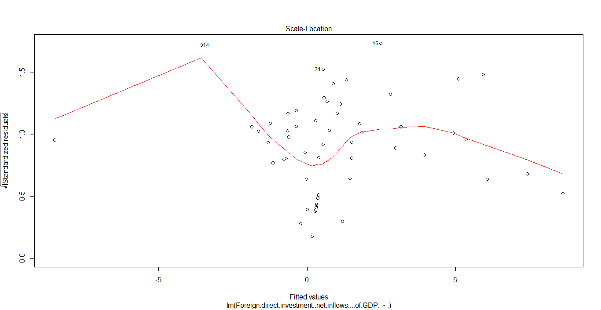
Results: Assumptions observed for MLR
Assumption 3: Homo or Heteroscedacity?

Slide 19
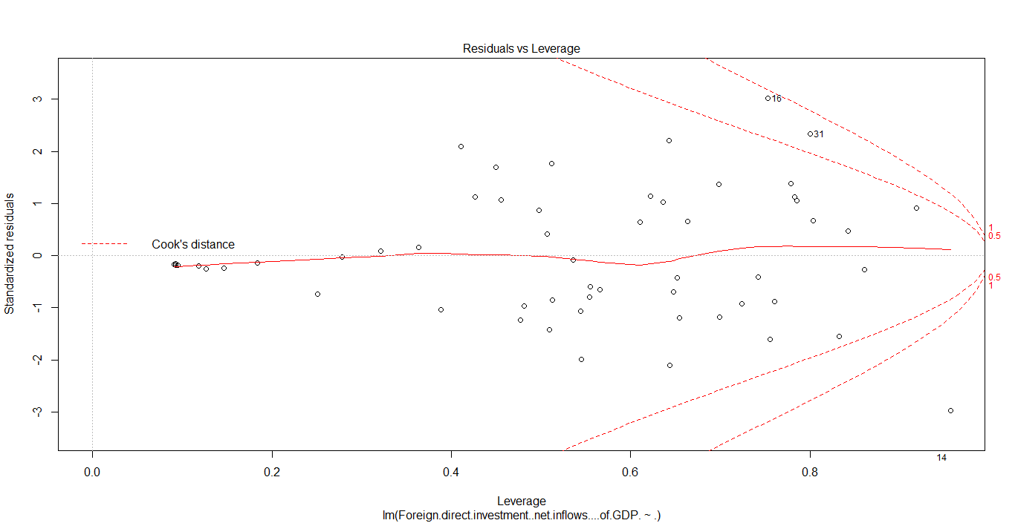
Results: Assumptions observed for MLR
Assumption 4:Are there outliers?

Slide 20
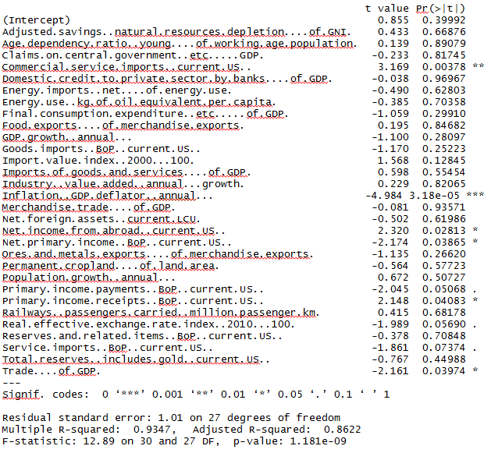
Results:
Significant Attributes from “MLR”

Slide 21
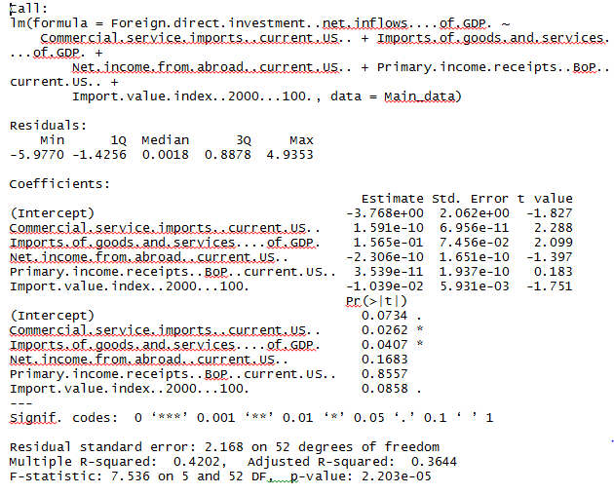
Results:
Significant Attributes from “stepAIC”

Slide 22
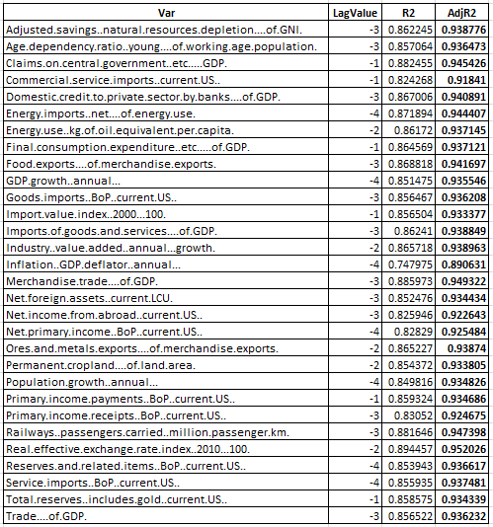
Results:
Time Series Lags

Slide 23
Conclusions:
Main factors which attracts FDI inflows into Saudi Arabia
Commercial.service.imports..current.US..
Inflation..GDP.deflator..annual
Net.income.from.abroad..current.US
Net.primary.income..BoP..current.US..
Primary.income.payments..BoP..current.US..
Real.effective.exchange.rate.index..2010...100
Service.imports..BoP..current.US
Primary.income.receipts..BoP..current.US.
Trade....of.GDP
Imports.of.goods.and.services....of.GDP.

Slide 24
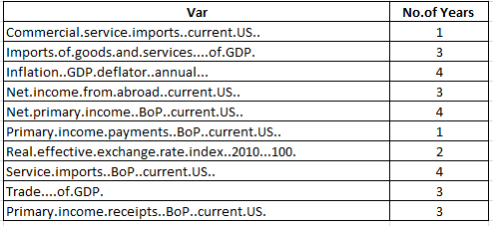
Conclusions:
Forecasting the FDI inflows for the above factors

Slide 25
Challenges:
Finding the reliable data
During extraction of data
All NAs not imputed during Time series imputation
Extracting top features from Random Forest
Finding out the Lags in time series

Slide 26
Thank you

